Slide 1
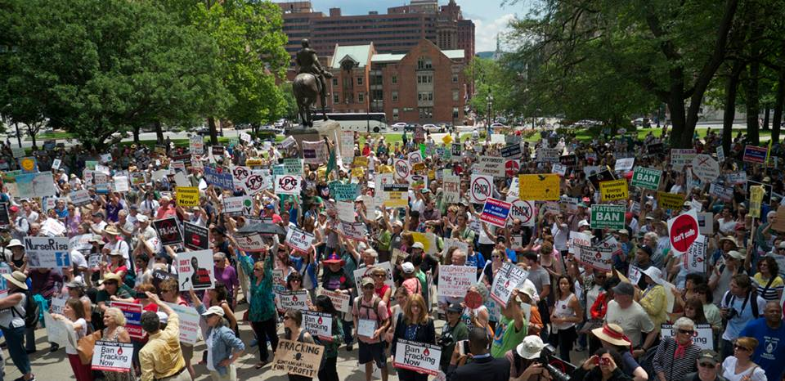
Fracked America:
Opposition Movement Ignited
By John Armstrong
John@FrackAction.com

Slide 2

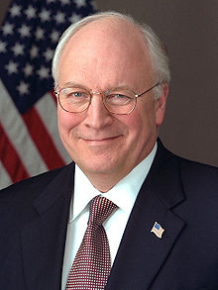
2005 US Exemptions

Slide 3
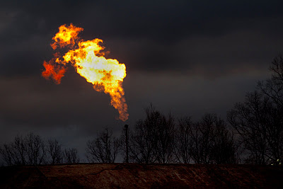
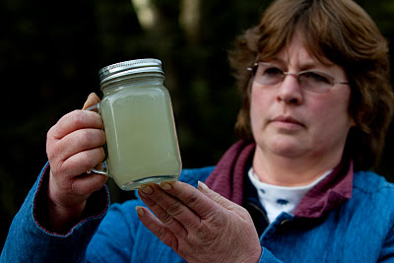
Unchecked & Unregulated
Photos by Les Stone

Slide 4
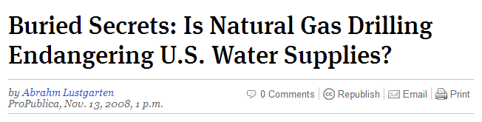
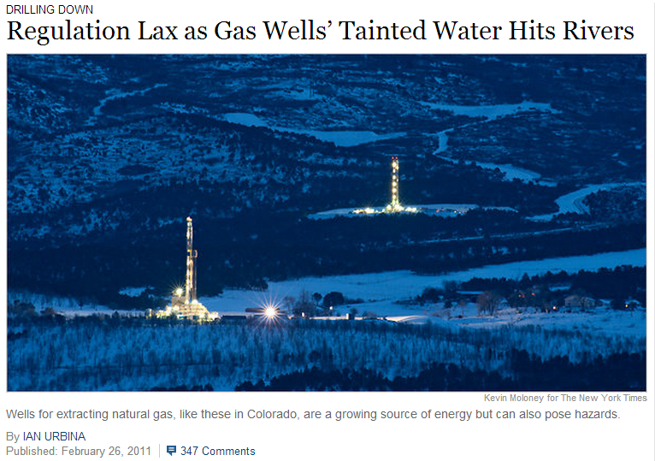

Slide 5

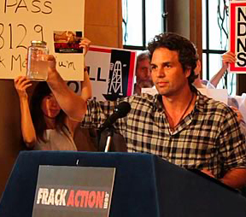
2008, 2010 New York Moratoria

Slide 6
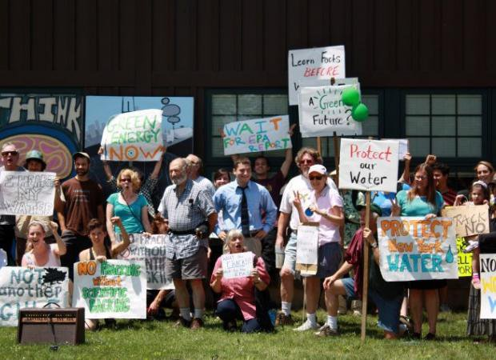
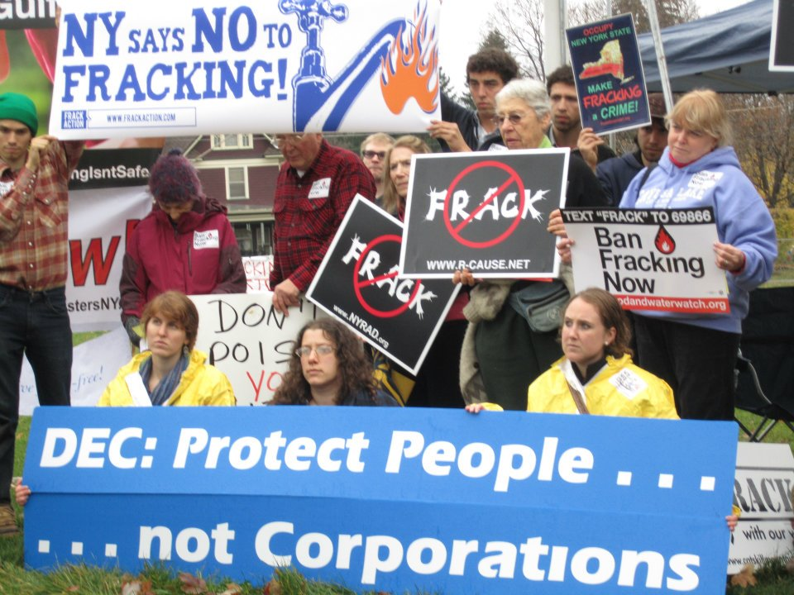
Grassroots Movement Grows

Slide 7
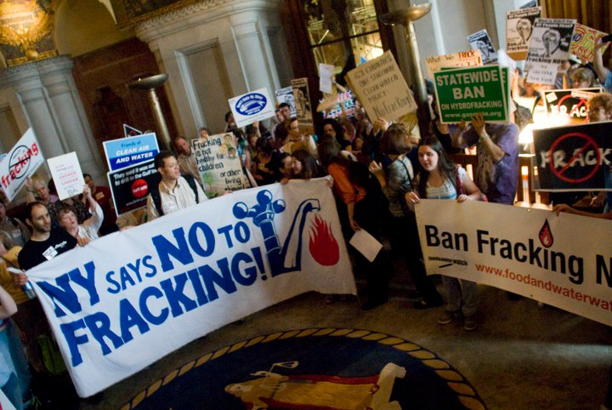
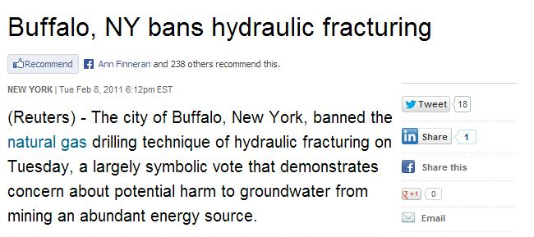
Call for a Ban

Slide 8
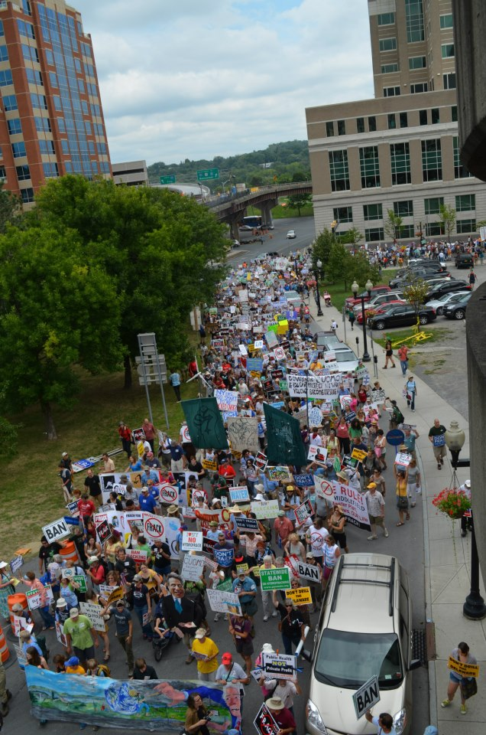
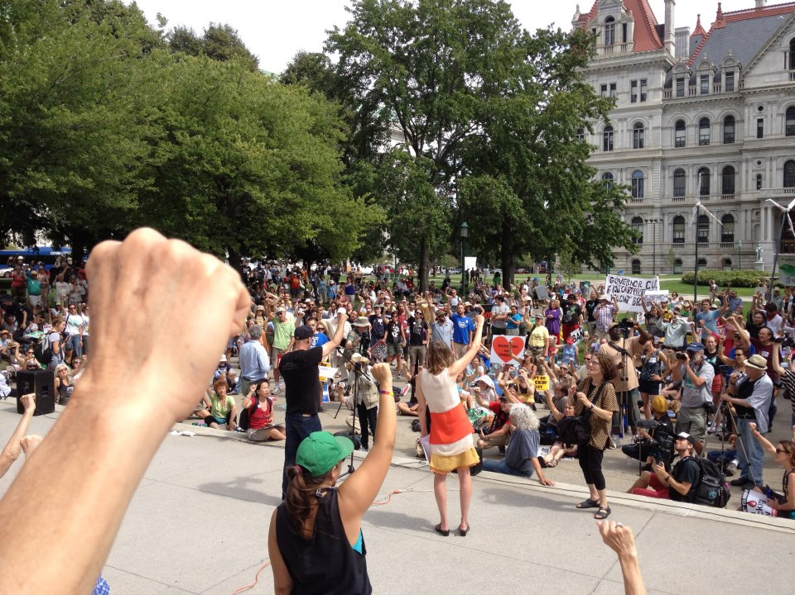
Coordinated Grassroots Power

Slide 9
Organizing Vision, Messaging Narratives and Political Strategy
Organizing Vision
Decentralized, community groups
Local education/awareness building
Statewide coordinated network
Mobilize constituency groups

Slide 10
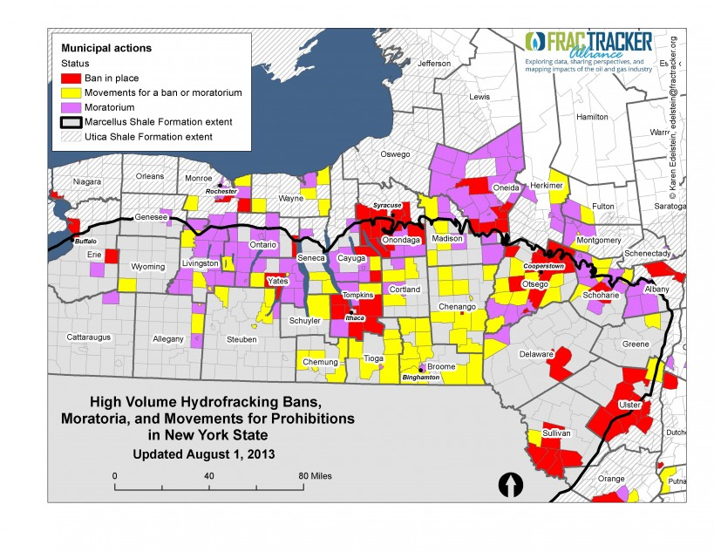

Slide 11
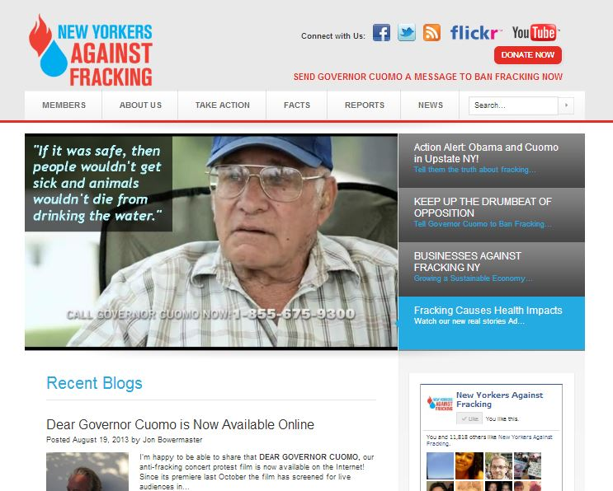
New Yorkers Against Fracking

Slide 12
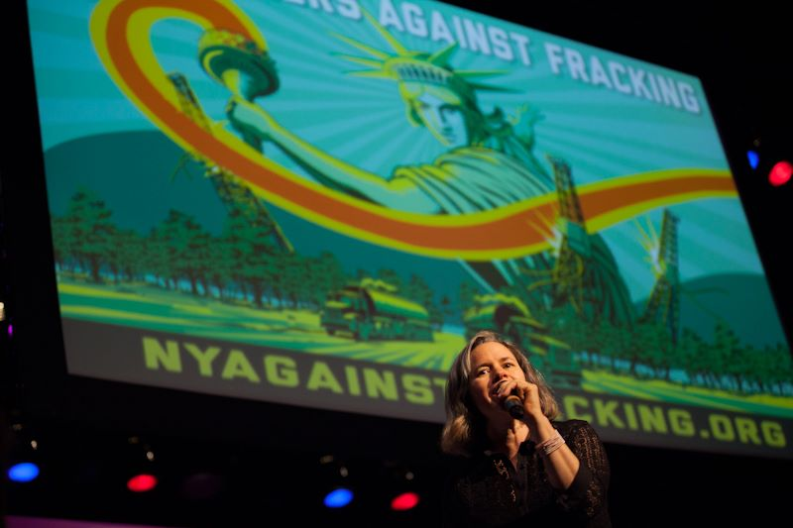


Slide 13

‘Dear Governor Cuomo’
www.Dear-Governor-Cuomo.com

Slide 14
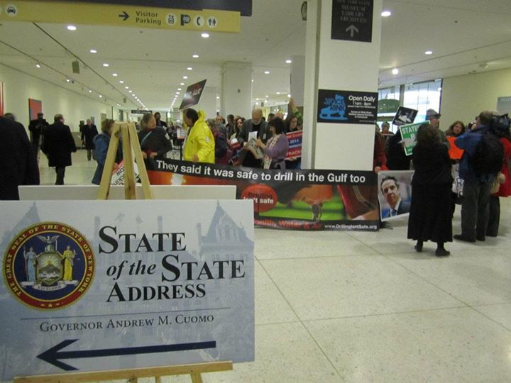
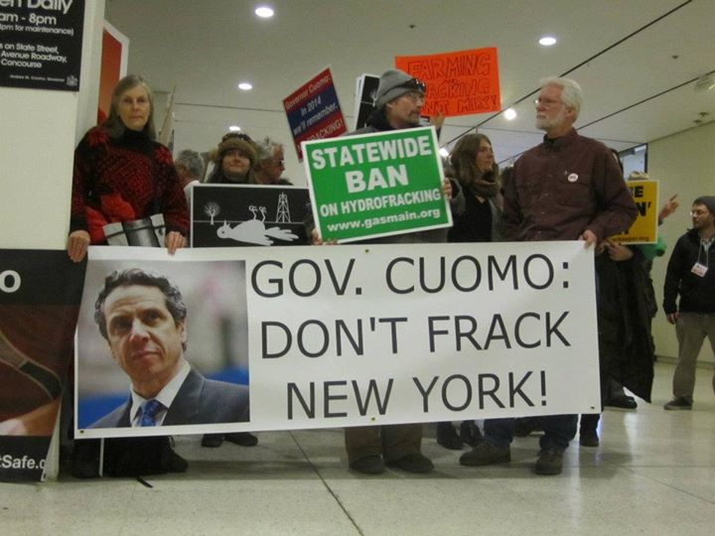
Political Strategy
Focus on the key decision maker
Constant pressure
State Legislature (individually & as a body)
Hearings, comment periods, etc
District actions & local elected officials

Slide 15
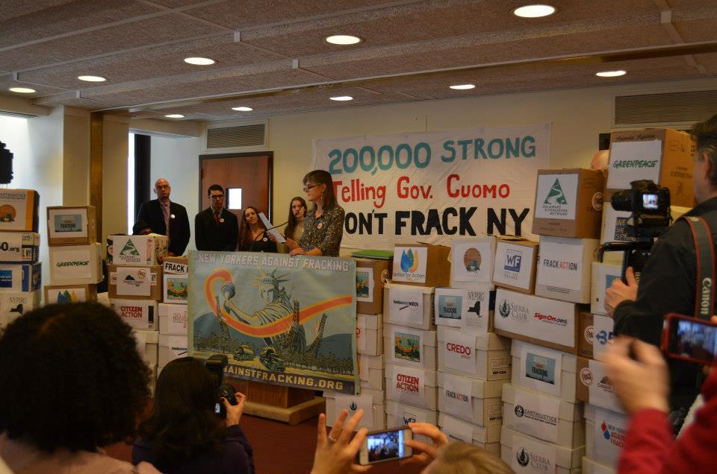

Slide 16
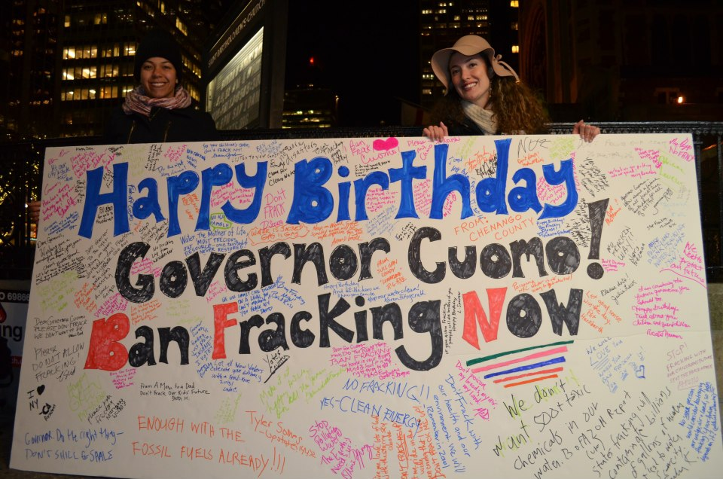
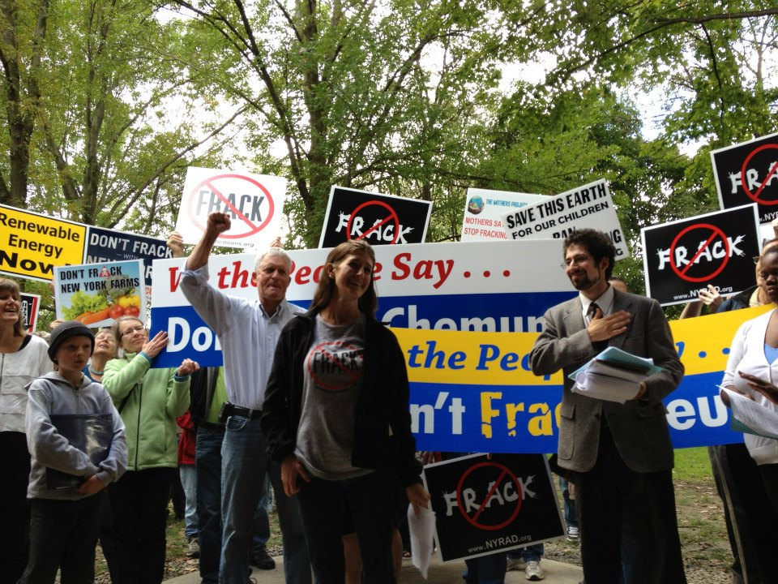

Slide 17
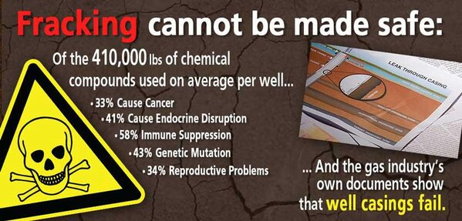
Messaging Narratives
Fracking cannot be done safely
Listen to the science & experts
All New Yorkers can and do oppose fracking
Not environment versus jobs
Public health, water, economics
Unite & amplify constituency groups
Press conferences, op-eds, LTEs, reports, etc

Slide 18
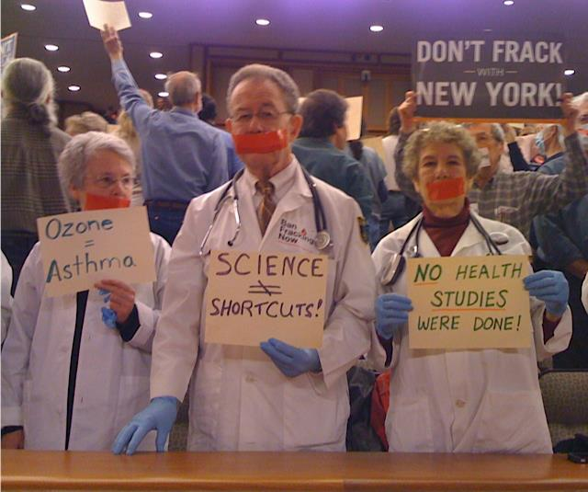
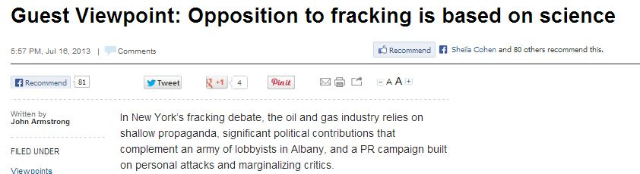

Slide 19

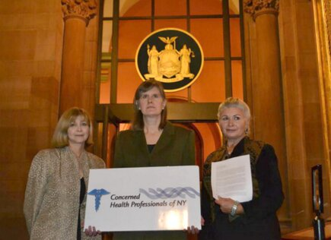
www.ConcernedHealthNY.org

Slide 20
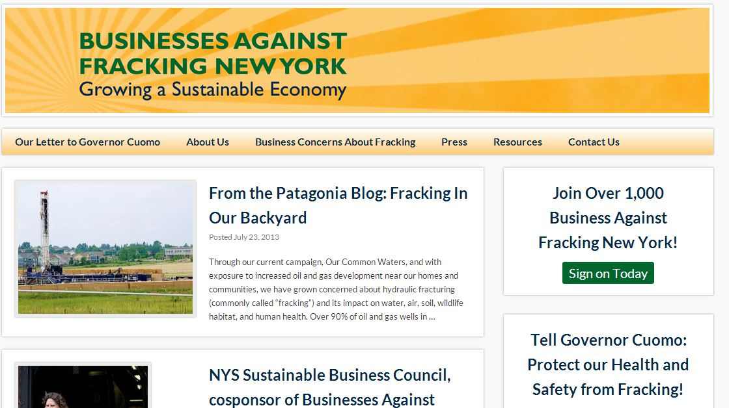
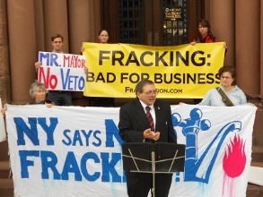
www. BusinessesAgainstFrackingNY.com

Slide 21
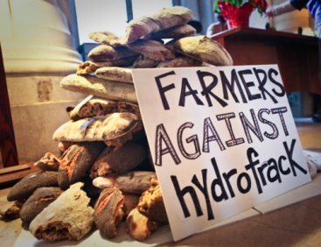
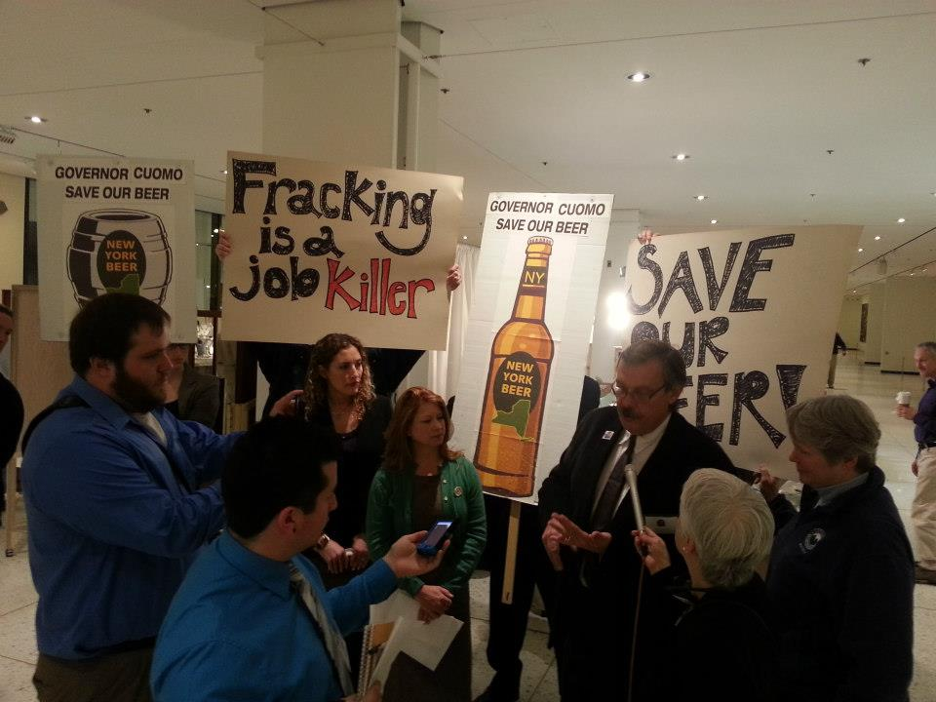

Slide 22

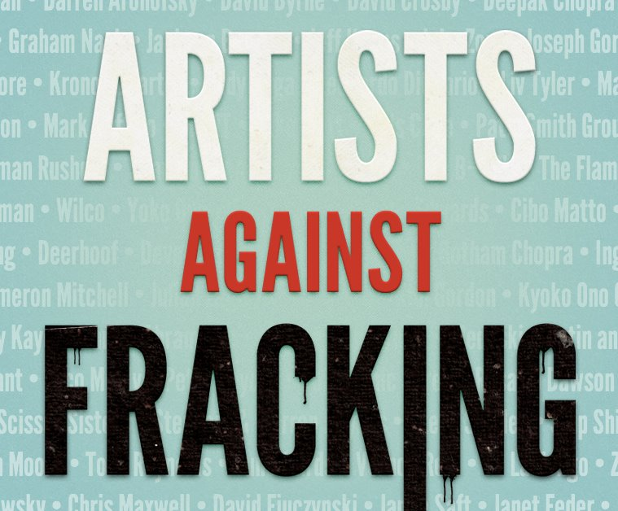



Slide 23
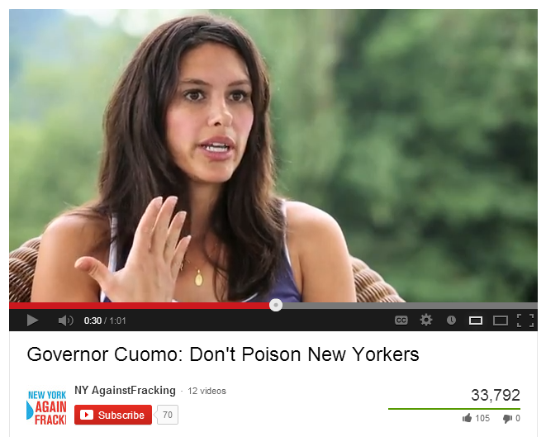
Voices & Experiences from PA

Slide 24

www.NYElectedOfficials.org

Slide 25
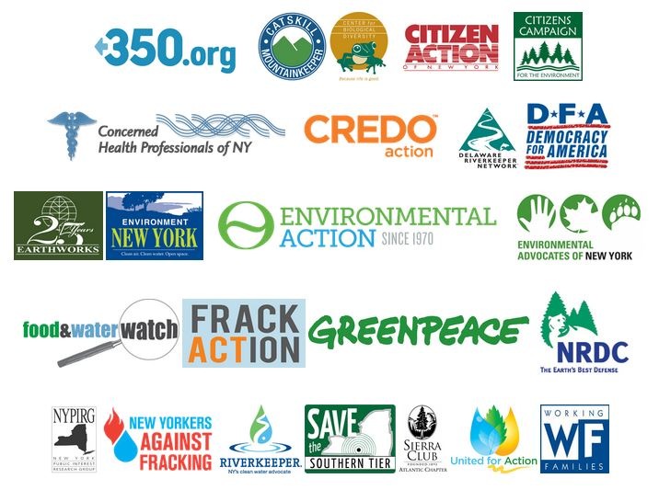
United Front

Slide 26
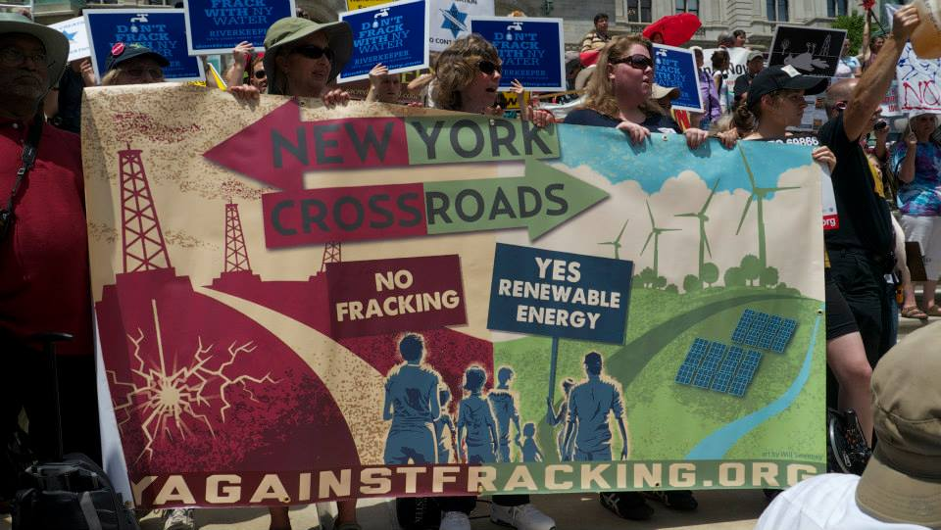
For Renewables

Slide 27
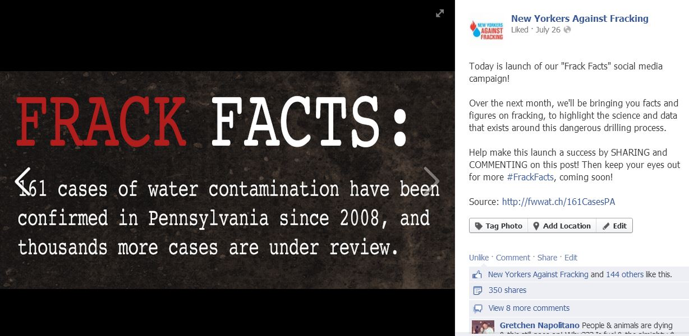
Still Growing
The more people know, the more they oppose fracking

Slide 28
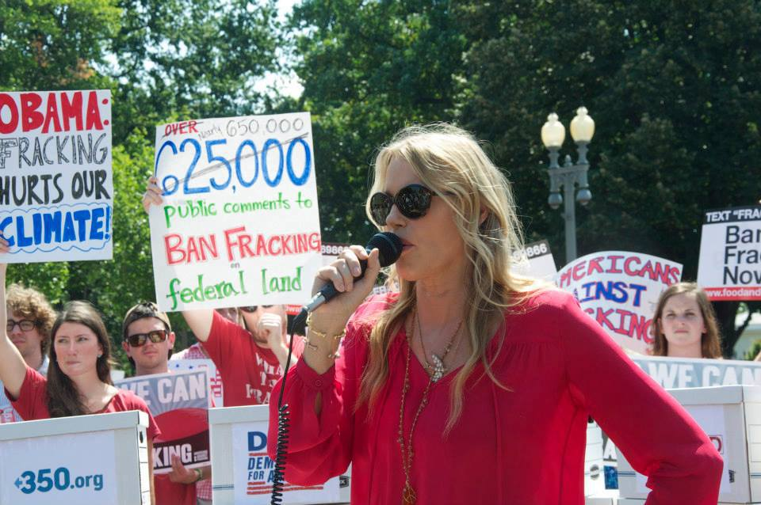
Americans Against Fracking
www.AmericansAgainstFracking.org

Slide 29
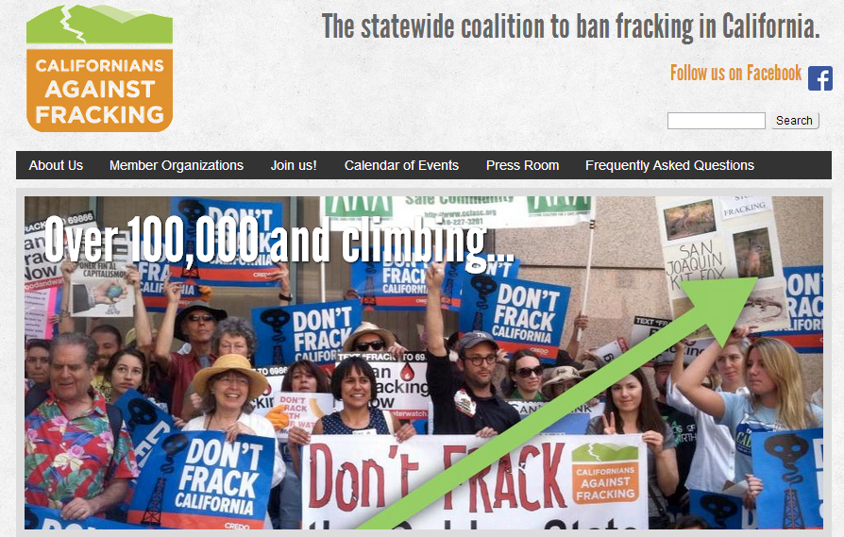
Californians Against Fracking
www.CaliforniansAgainstFracking.org

Slide 30
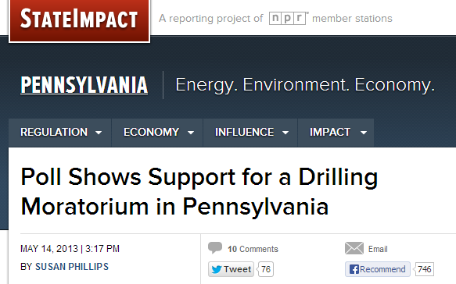
PA Supports Moratorium
Democratic party comes out for statewide moratorium

Slide 31
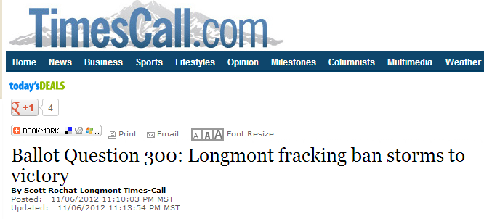
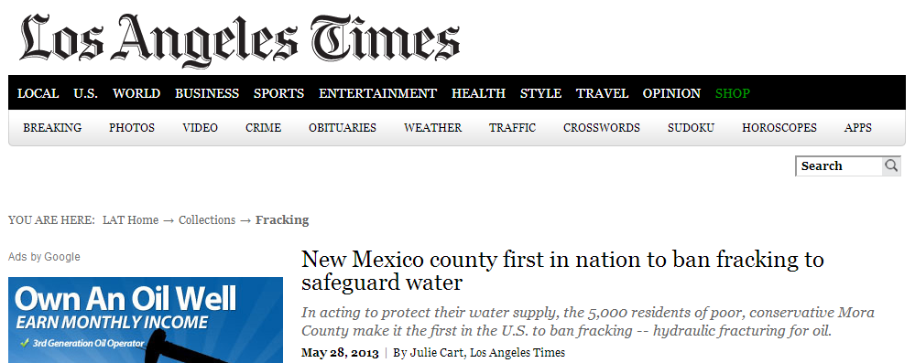
Opposition Growing Nationwide

Slide 32
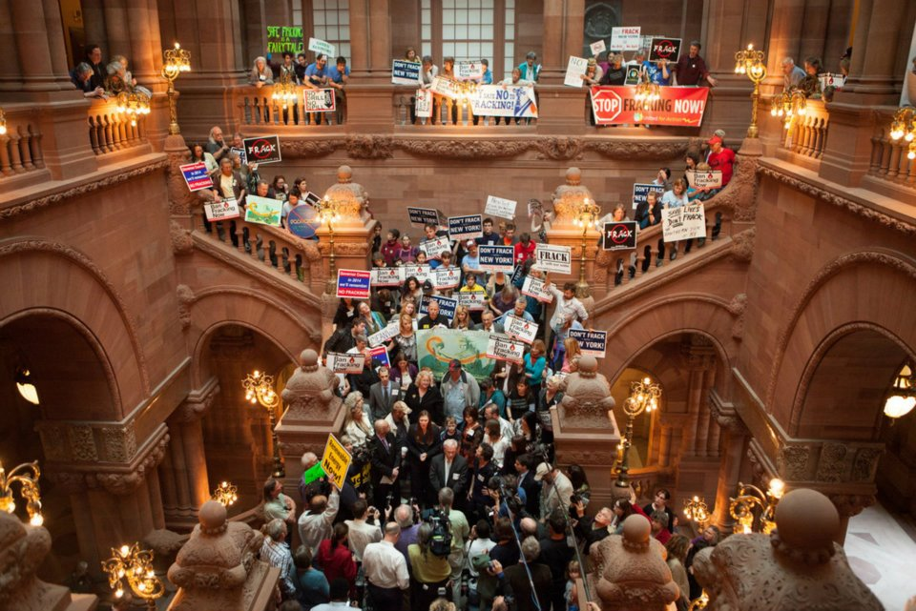
Thank You
John@FrackAction.com

